Slide 1
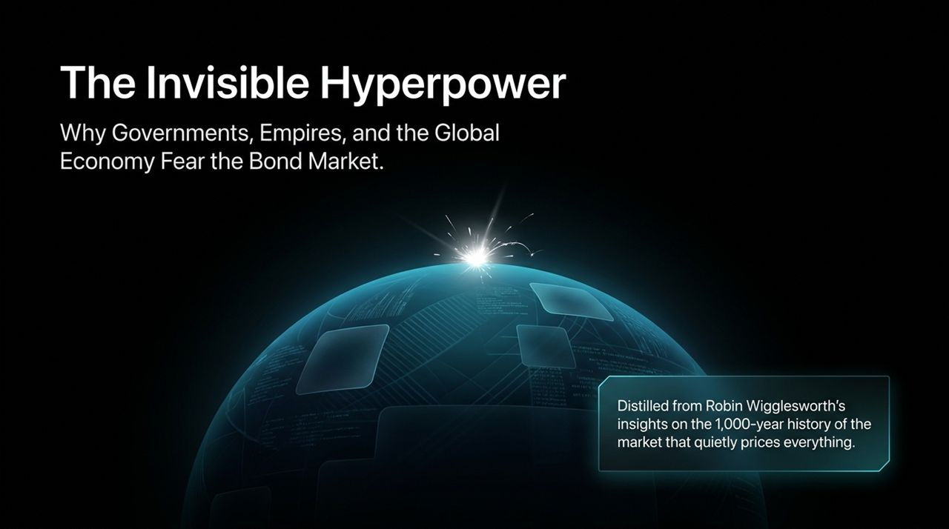
Notes:
Opening Hook: Good morning/afternoon, everyone. When we turn on financial news or check our phones, the stock market steals all the spotlight. We see tickers for the S&P 500, the Dow Jones, or big tech stocks every single day. But today, we’re going to talk about the asset class that quietly dictates the price of everything else in the global economy: the Bond Market.
Setting the Scene: Financial Times editor Robin Wigglesworth calls the bond market the "invisible hyperpower". Over the next 45 to 60 minutes, we are going to explore a 1,000-year historical journey—from 12th-century Venice to modern Wall Street—to understand why governments, sovereign empires, and central bankers fear the bond market far more than they fear political rivals or equity crashes.
Key Takeaway: Bonds are often perceived as the boring, sleepy corner of finance—the place you go to hide when things are on fire elsewhere. But as we’ll see today, bonds are actually the bedrock of global capitalism, the mechanism that built modern nation-states, and the ultimate arbiter of political power.
https://www.youtube.com/watch?v=b6K7Pe8zohk

Slide 2
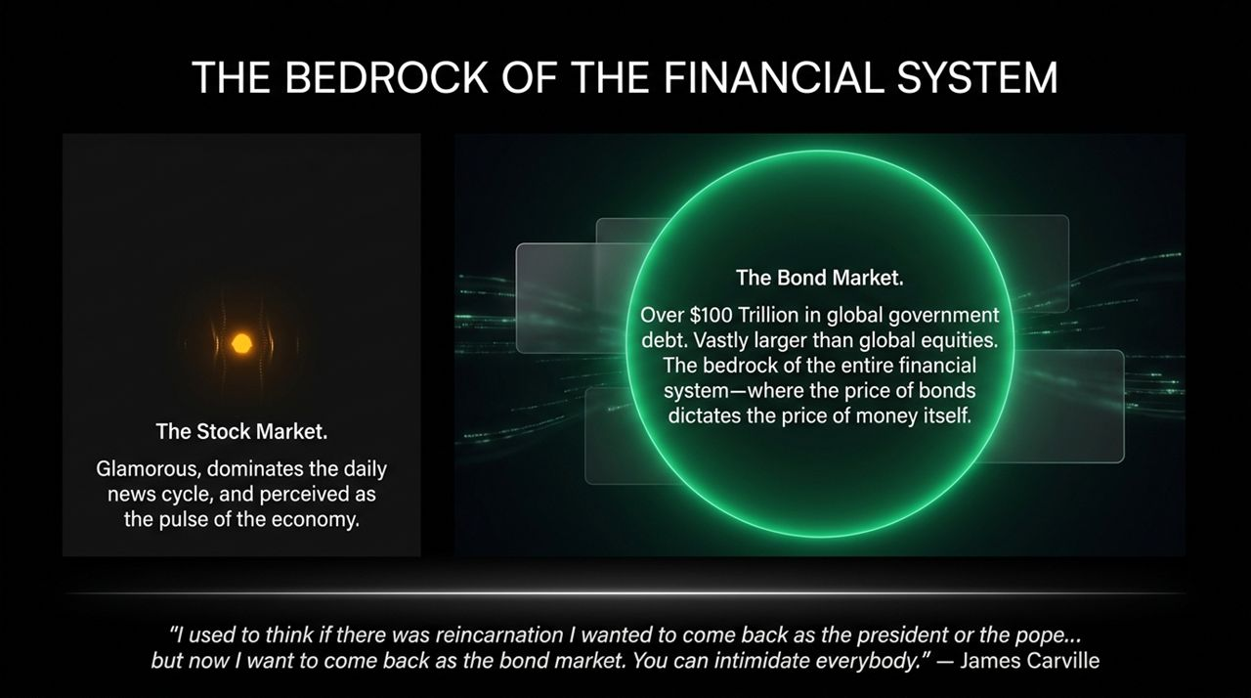
Notes:
The Visual Contrast: Let’s look at the stark contrast between how the public views finance versus how the financial system actually works.
The Glamour of Equities: Equities dominate headlines because they represent companies we interact with every day—Apple, Tesla, Amazon. They are volatile, media-friendly, and perceived as the real-time pulse of the economy.
The Reality of Fixed Income: But in reality, the global sovereign and corporate bond market totals well over $100 Trillion. It vastly dwarfs global equities.
"The Price of Money": As Robin Wigglesworth points out, the price of bonds is effectively the price of money itself. Risk-free government bond yields set the discount rate for every asset on Earth—from corporate loans and mortgages to tech valuations and venture capital.
The Iconic Quote: Clinton strategist James Carville famously captured this raw authority in 1993. After watching the bond market force President Clinton to abandon key economic campaign promises, Carville remarked: "I used to think if there was reincarnation I wanted to come back as the president or the pope... but now I want to come back as the bond market. You can intimidate everybody."
Transition: Today we’ll look at how this market acquired that level of intimidation and structural dominance.

Slide 3
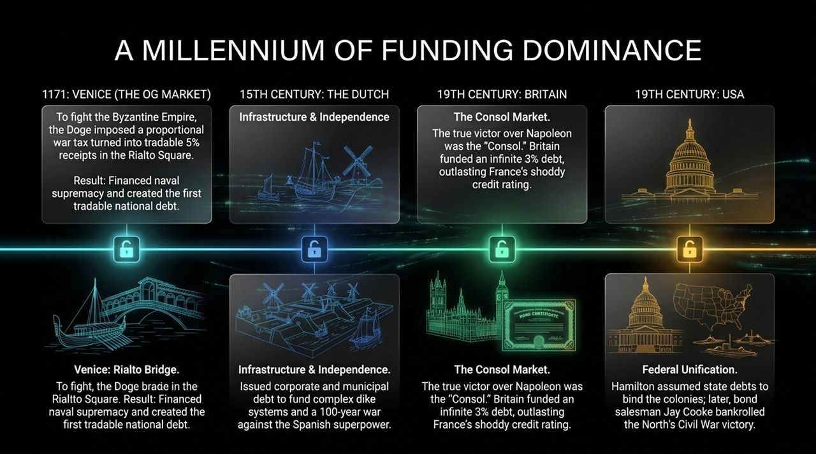
Notes:
Historical Context: To understand modern fixed income, we have to recognize that bonds were not created by economists in a boardroom; they were forged in war, crisis, and existential nation-building.
1171 Venice (The OG Market): The birth of tradable debt happened in 12th-century Venice. Faced with conflict against the Byzantine Empire, the Doge of Venice imposed a proportional war levy on citizens. Instead of taking it as a pure tax, Venice promised a 5% annual payout and allowed these receipts to be bought and sold in the Rialto Square. This created the world's first tradable national debt.
15th Century Dutch Republic: The Dutch took this technology further. They issued municipal and corporate debt to build intricate dike systems to reclaim land from the sea, and later used that same capital engine to fund a 100-year war of independence against the Spanish Empire—the hyperpower of the era.
19th Century Britain: During the Napoleonic Wars, it wasn’t just naval brilliance or army tactics that defeated Napoleon; it was Britain’s ability to fund an infinite stream of 3% "Consols" (Consolidated Annuities). Britain out-borrowed and out-lasted France, whose credit rating was atrocious.
19th Century USA: Alexander Hamilton explicitly assumed state debts to bind the former colonies into a cohesive federal union, and salesman Jay Cooke later sold Union war bonds directly to the public to bankroll victory in the Civil War.

Slide 4
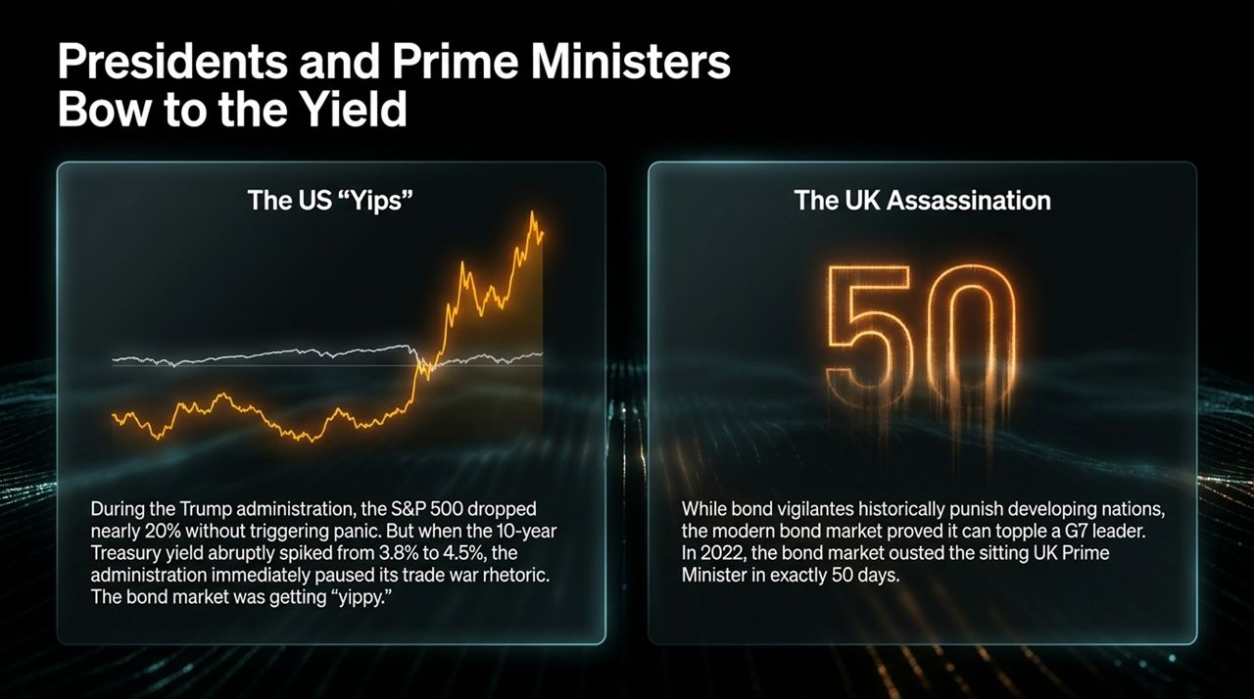
Notes:
Modern Political Reality: We often think "bond vigilantes" only discipline small, developing emerging markets. But recent history shows that even G7 superpowers are at the mercy of bond yields.
Case Study 1: The US "Yips" (Trump Administration): During trade tensions, the S&P 500 dropped nearly 20% without forcing an immediate policy retreat from Washington. However, when the 10-year Treasury yield rapidly spiked from 3.8% to 4.5%, the administration paused its trade war escalation. President Trump himself noted that the bond market was getting "yippy". Equity drops can be ignored; bond market spikes cannot.
Case Study 2: The UK Policy Assassination (2022): In 2022, UK Prime Minister Liz Truss introduced a mini-budget with sweeping unfunded tax cuts amid high inflation. The bond market revolted almost instantly. British Gilt prices collapsed, yields spiked, and Truss was forced out of office in just 50 days—making her the shortest-tenured Prime Minister in British history.
Takeaway: The bond market acts as an unyielding, non-partisan referee. When government fiscal policy strays too far from reality, the yield curve will execute a veto that politicians cannot override.

Slide 5
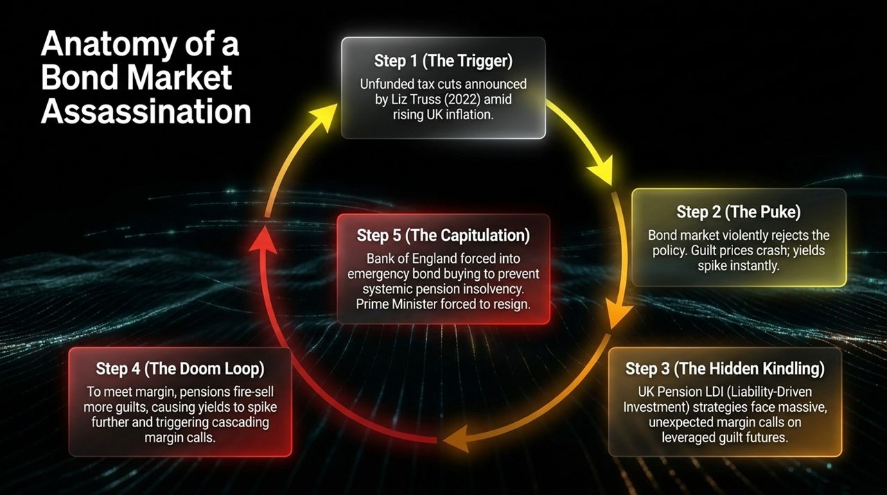
Notes:
Deconstructing the UK Crisis: Slide 5 walks step-by-step through the mechanics of the 2022 UK Gilt crisis—a textbook example of hidden structural leverage meeting a fiscal catalyst.
Step 1 (The Trigger): Liz Truss announces large, unfunded tax cuts while inflation is running high.
Step 2 (The Puke): Bond investors aggressively sell off British Gilts. Prices plummet and yields surge.
Step 3 (The Hidden Kindling): What politicians didn't realize was that UK pension funds had widely adopted LDI (Liability-Driven Investment) strategies. To match long-term pension liabilities, these funds used leverage via Gilt futures and derivatives.
Step 4 (The Doom Loop): As Gilt prices fell, pension funds received massive, unexpected margin calls. To raise cash to meet these margin calls, they were forced to fire-sell more Gilts into an illiquid market. This pushed prices down further, triggering more margin calls in a self-reinforcing death spiral.
Step 5 (The Capitulation): The Bank of England was forced to intervene with emergency bond-buying operations to prevent widespread pension insolvency. The political fallout was immediate: Liz Truss resigned shortly after.

Slide 6
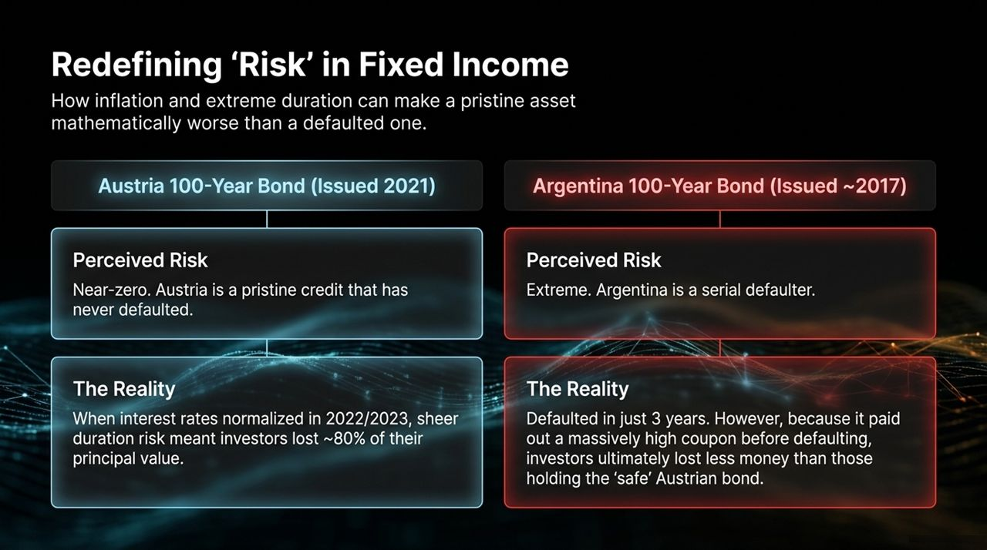
Notes:
Challenging Assumptions: In traditional finance, we are taught that sovereign bonds from developed nations are "risk-free" while emerging market debt is volatile and dangerous. Robin Wigglesworth highlights a fascinating counter-example from recent years that turns this assumption on its head.
Austria’s 100-Year Bond (Issued ~2021): Austria is a pristine Eurozone credit that has never defaulted. During the ultra-low interest rate era, Austria issued a 100-year bond with a microscopic coupon yield. When interest rates normalized globally in 2022–2023, extreme duration risk devastated the bond. Investors holding this pristine, "safe" asset saw its market value crash by nearly 80%.
Argentina’s 100-Year Bond (Issued ~2017): Conversely, Argentina—a serial default state—issued a 100-year bond paying a sky-high coupon yield. Predictably, Argentina defaulted just 3 years later. But because investors received high coupon payouts prior to the default, they ultimately lost less money than those holding the "safe" 100-year Austrian bond.
Lesson: "Safe" credit ratings do not insulate an investor from structural duration risk. Mathematical interest rate sensitivity can inflict worse losses than credit default.

Slide 7
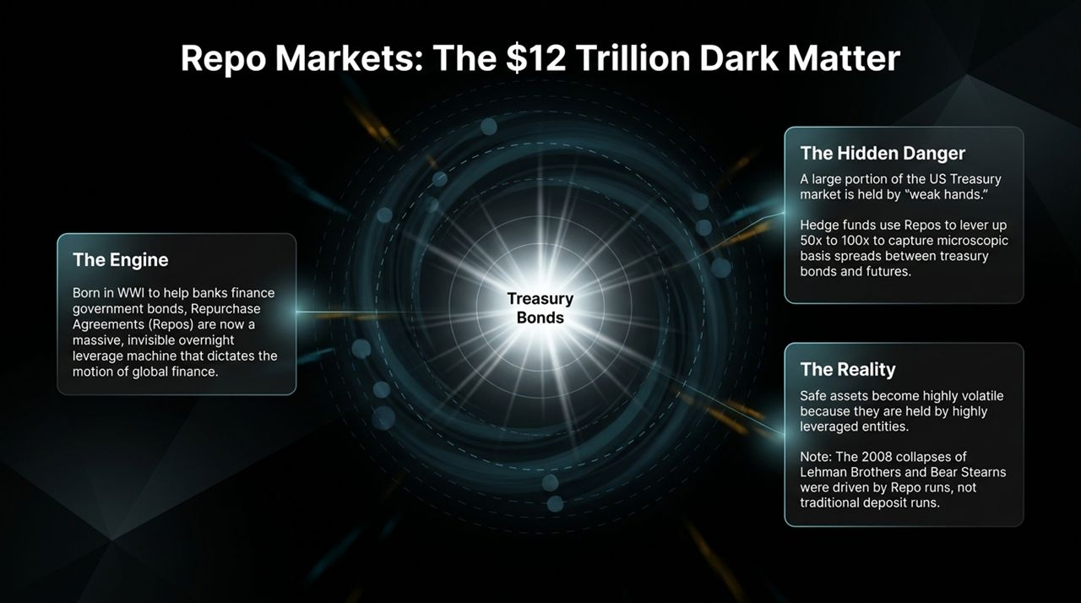
Notes:
What is the Repo Market? Repurchase Agreements (Repos) were born during World War I to help commercial banks finance government bond purchases. Today, the US Repo market is a massive $12 Trillion collateral engine. Wigglesworth compares it to the "dark matter of finance"—invisible to everyday observers, yet dictating the motion of the entire financial universe.
The Basis Trade & Leverage: A substantial portion of US Treasuries is held not by long-term buy-and-hold investors, but by hedge funds engaging in the "basis trade". They exploit microscopic price discrepancies between Treasury bonds and futures contracts. Because these spreads are tiny, funds apply 50x to 100x leverage using overnight Repos.
Structural Fragility: This means pristine Treasury bonds are held by highly leveraged "weak hands". When liquidity dries up or repo rates spike, these positions face rapid liquidation.
Historical Context: It’s worth remembering that the 2008 collapses of Bear Stearns and Lehman Brothers were not standard retail bank runs; they were overnight Repo runs.

Slide 8
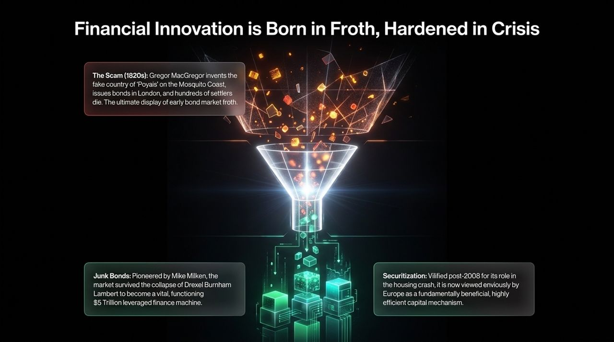
Notes:
The Cycle of Innovation: Financial history follows a recurring pattern: human ingenuity creates new instruments, market euphoria drives them to extreme froth, a crash wipes out the bad actors/frauds, and the underlying structural tool survives to become essential market infrastructure.
1820s Poyais Fraud: Gregor MacGregor invented a completely fake Central American country called "Poyais," complete with fake guidebooks and land grants, and issued sovereign bonds in London. Settlers sailed out only to find a barren jungle, and hundreds died. It was the ultimate demonstration of early fixed-income speculative froth.
Junk Bonds (1980s): Mike Milken transformed high-yield "junk bonds" from a niche market into a major corporate funding mechanism. Despite the scandal and collapse of Drexel Burnham Lambert, high-yield debt survived to become a $5 Trillion market supporting corporate growth globally.
Securitization (2000s to Present): Securitization and Mortgage-Backed Securities were vilified after the 2008 global financial crisis. Yet today, European policymakers actively envy the US securitization market as a highly efficient capital allocation mechanism.

Slide 9
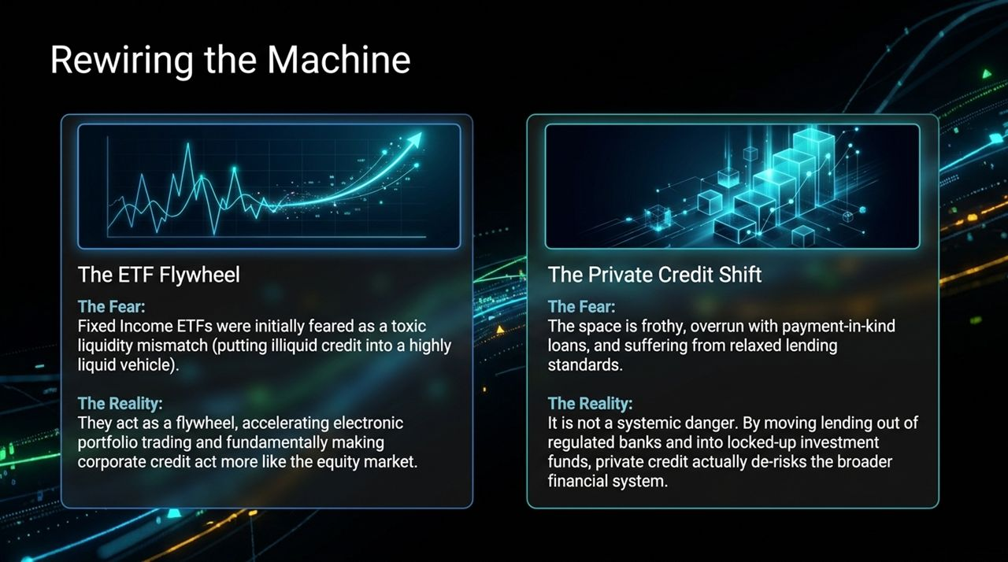
Notes:
Modern Evolution: Fixed income is undergoing a rapid modernization driven by two major market structure shifts.
1. Fixed Income ETFs:
The Fear: Early critics (including prominent hedge fund managers) warned that putting illiquid corporate bonds into daily-liquid ETF vehicles would lead to severe liquidity mismatches during a downturn.
The Reality: Fixed income ETFs have acted as a flywheel. They accelerated electronic portfolio trading, increased market transparency, and made corporate credit trade more smoothly like equity markets.
2. The Private Credit Boom:
The Fear: Fast-growing private credit markets are becoming frothy, with relaxed underwriting standards and increasing use of Payment-in-Kind (PIK) notes.
The Reality: While individual private credit managers will face losses during credit cycles, the overall shift is non-systemic. Moving corporate lending out of fractional-reserve commercial banks and into locked-up, un-leveraged investment funds actually reduces systemic banking risk.

Slide 10
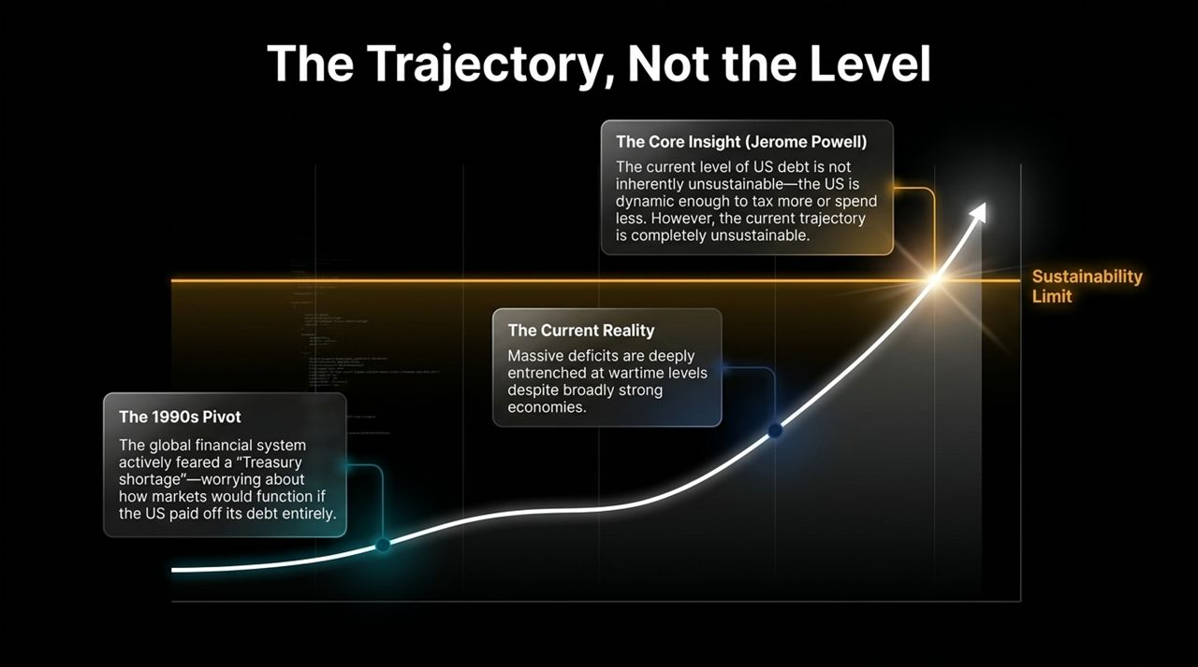
Notes:
Sovereign Debt Realities: Global government debt has reached historic heights, but how concerned should we be?
The 1990s Contrast: In the late 1990s, the US government ran budget surpluses. Financial markets actually began worrying about a "Treasury shortage"—wondering how global markets could price risk if US national debt was paid off completely.
Today’s Environment: Today, developed nations maintain persistent deficit spending comparable to wartime eras, even during periods of economic expansion.
Jerome Powell’s Insight: Fed Chair Jerome Powell clearly articulated the distinction between debt level and debt trajectory: The absolute level of US debt is not currently unsustainable because the US economy remains dynamic. However, the current growth trajectory of debt outstripping economic growth is mathematically unsustainable over the long term.
Conclusion: Sovereign debt sustainability is an ongoing structural challenge that requires proactive fiscal adjustment before the bond market enforces its own correction.

Slide 11

Notes:
Core Theme 1: Bonds Dictate Political Reality. Politicians make campaign promises, but the bond market determines what is fiscally achievable. It serves as the ultimate veto power over unsustainable policy.
Core Theme 2: "Safe" is an Illusion. Structural duration risk (as seen in 100-year century bonds) and extreme leverage (as seen in the $12 Trillion Repo market) can turn supposedly "boring" fixed income assets into sources of sharp volatility.
Core Theme 3: Structure is Destiny. From 12th-century Venetian war loans to modern private credit and ETF infrastructure, the mechanics of how debt is structured and traded dictate economic growth and global power.

Slide 12
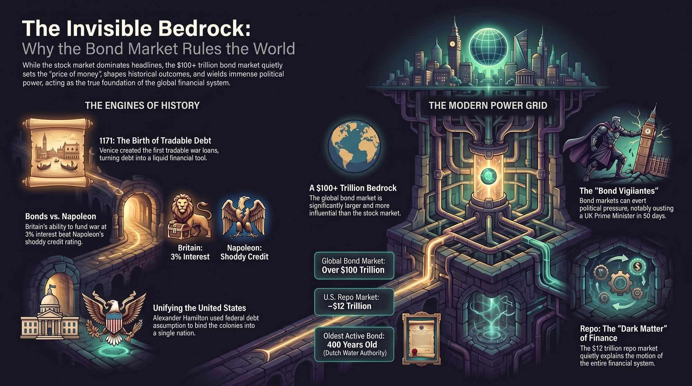
Notes:
Concluding Review: To tie our narrative together, Slide 12 provides an infographic overview of the key themes discussed:
1171 Venice: Invented tradable debt as a temporary war measure, inadvertently creating modern fixed income.
Consols vs. Napoleon: British 3% Consols provided the financial endurance to defeat France.
Hamiltonian Debt: Federal assumption of debt unified the American states into a single economic power.
The $100+ Trillion Market: Fixed income remains the primary benchmark for global capital.
The $12 Trillion Repo Engine: The unseen collateral system powering modern market liquidity.
Final Closing: Thank you for your time. I am happy to open the floor to any questions or discussion.

